Slide 1

The Modern Software
Developer
CS146S
Stanford University, Fall 2025
Mihail Eric
themodernsoftware.dev

Slide 2
LLM Power Prompting
themodernsoftware.dev

Slide 3
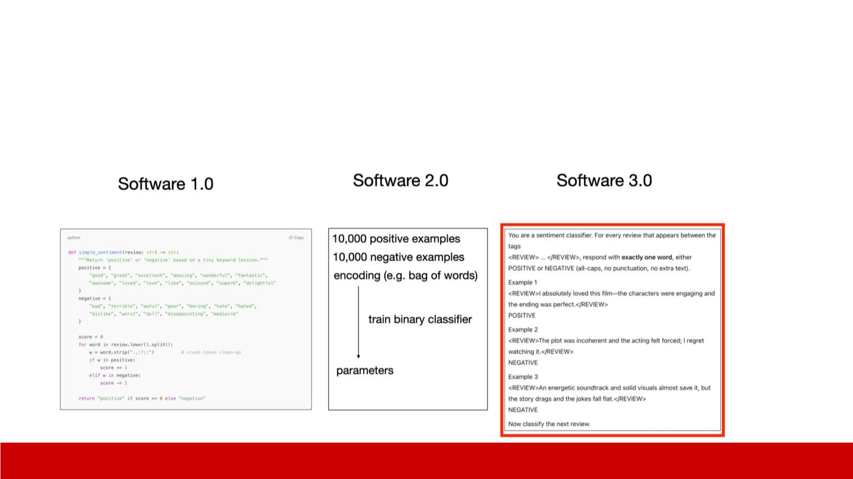
Prompting background
● Prompts are the lingua franca for getting LLMs to do what we want and also
effectively programming them
提示词是让大语言模型按照我们的需求执行任务的通用语言，也是对其进行高效编程的方式
Courtesy of
Andrej Karpathy
themodernsoftware.dev

Slide 4
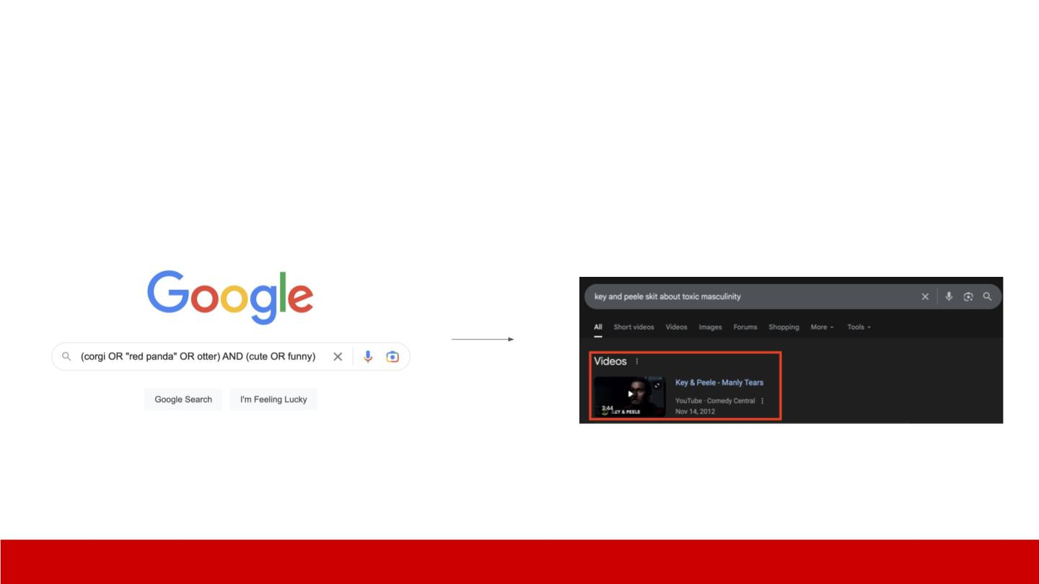
An analogy
● Look to how we’ve changed our search engine interactions
参考我们与搜索引擎的交互方式变化
themodernsoftware.dev

Slide 5
Prompting Background
● Prompting is both an art and a science
● Black-box nature of LLMs means there’s some magic to LLM-whispering
effectively
● …but there are established techniques that have empirically improved LLM
performance
提示词设计既是一门艺术，也是一门科学
大语言模型的“黑箱”特性，意味着想要高效驾驭它需要一些技巧
但也有经过实践验证、能提升大语言模型表现的成熟方法
themodernsoftware.dev

Slide 6

Zero-shot prompting
零样本提示词
● Ask the LLM to do a thing
直接让大语言模型执行任务
无辅助信息
无示例参考
○
○
no support
no examples
Write me a Rust for-loop that iterates over a list of strings
for every, printing every value in an even index
themodernsoftware.dev

Slide 7
K-shot prompting
K样本提示词页
● Ask the LLM to do the thing but give it some examples of how to do it
○ Sometimes called in-context learning
● k-shot
○ 1, 3, 5 (some empirical results justify these numbers)
● Ideal for tasks that don’t have too many reasoning steps
让大语言模型执行任务，同时提供相关执行示例
有时也被称为上下文学习
K 样本数量
1、3、5 个（部分实证研究验证了这些数量的有效性）
适用于推理步骤不复杂的任务
themodernsoftware.dev

Slide 8
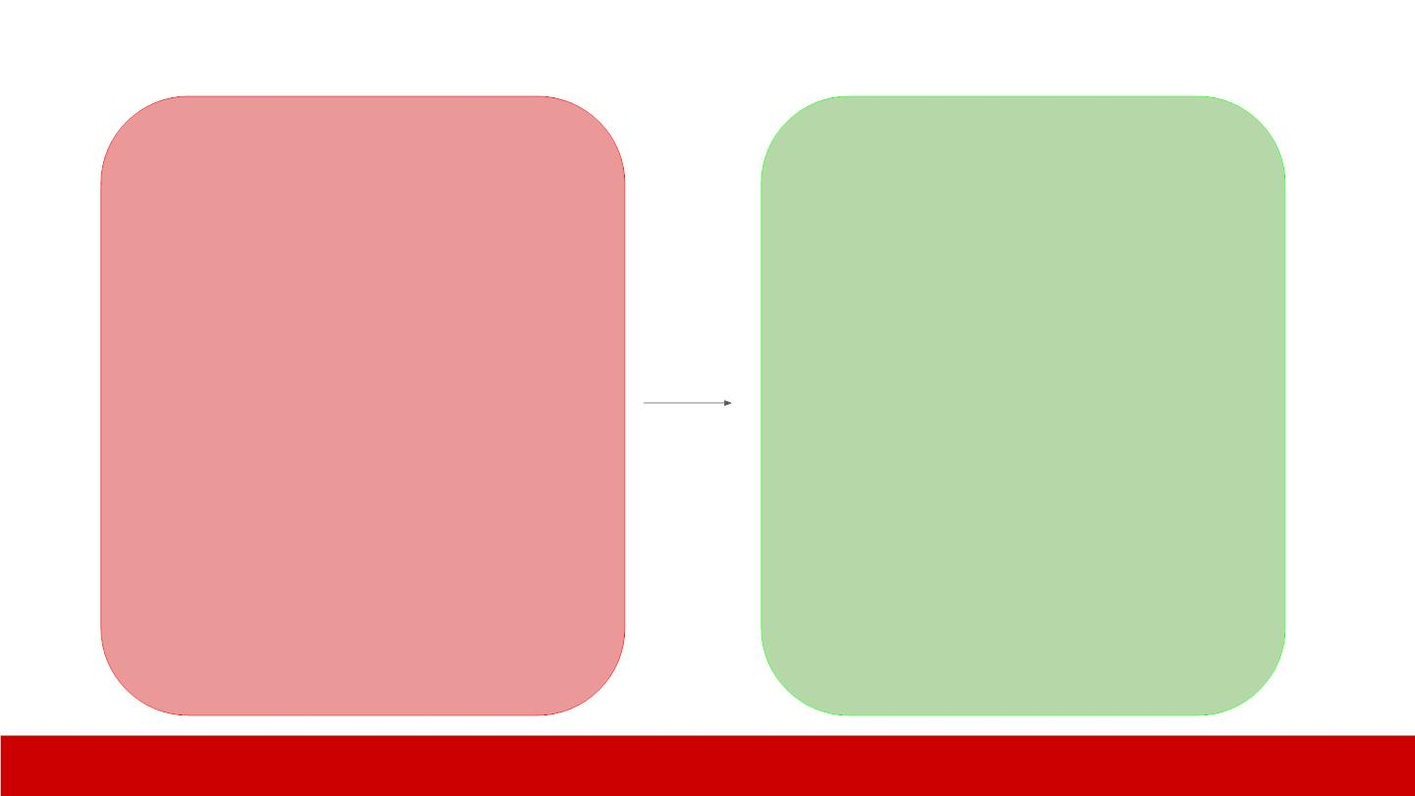
Write a for-loop iterating over a list of
strings using the naming convention
in our repo. Here are some examples
of how we typically format variable
names.
Write a for-loop iterating over a
list of strings using the naming
convention in our repo.
<example>
var StRaRrAy = [‘cat’, ‘dog’, ‘wombat’]
</example>
<example>
def func CaPiTaLiZeStR = () => {}
</example>
themodernsoftware.dev

Slide 9
Chain-of-Thought Prompting
思维链提示词
● Show reasoning steps for a given task
为指定任务展示推理步骤
多样本思维链（Multi-shot CoT）
给出完整的推理轨迹示例
零样本思维链（Zero-shot CoT）
直接加入提示语：“让我们一步步思考”
在提示词中用<reasoning>标签明确要求输出推理过程
适用于包含多个逻辑步骤的任务
编程
数学计算
○
○
○
Multi-shot CoT
■
Work out reasoning traces
Zero-shot CoT
■
“Let’s think step-by-step”
Prompt for reasoning in explicit <reasoning> tags
● Best for steps with multiple logical steps
○
○
Programming
Math
themodernsoftware.dev

Slide 10
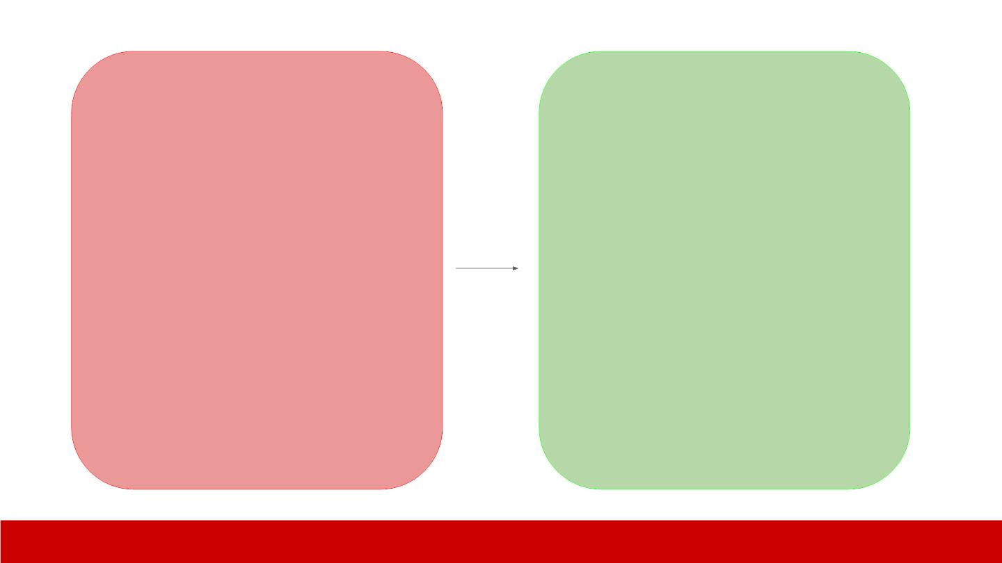
Multi-shot CoT
I want to write a function to check if a
number is a perfect cube and a perfect
square. Make sure to provide your
reasoning first. Here are some examples
of how to provide reasoning for a coding
task.
<example>
Write a function that finds the maximum
element in a list.
Steps: Initialize a variable with the first
element. Traverse the list, comparing…
</example>
Write a function to check if a
number is a perfect cube and a
perfect square.
<example>
Write a function that checks is a number
is a palindrome
Steps: Take the number. Reverse the
elements in the numbers. Check if …
</example>
themodernsoftware.dev

Slide 11
Zero-shot CoT
Write a function to find the longest
increasing subsequence in an array.
Think step by step about the
subproblems before coding. Include
worked out examples of subarrays
you are considering as you answer
this question.
Write a function to find the
longest increasing subsequence
in an array.
themodernsoftware.dev

Slide 12
Self-consistency Prompting
自洽性提示词
● Sample multiple times from output (typically with CoT) and aggregate most
common results
● Reduces hallucinations/incorrect answers via a form of model ensembling by
sampling diverse reasoning paths
让模型对同一任务多次生成输出（通常结合思维链），并取出现频次最高的结果
通过采样不同的推理路径实现模型集成效果，从而减少幻觉问题与错误答案
themodernsoftware.dev

Slide 13

What’s the root cause for this error:
Traceback (most recent call last):
File "example.py", line 3, in
<module>
print(nums[i])
IndexError: list index out of range
What’s the root cause for this
error:
Traceback (most recent call last):
File "example.py", line 3, in
<module>
print(nums[i])
IndexError: list index out of range
Prompt 5x
Take majority result
themodernsoftware.dev

Slide 14
Tool Use
工具调用提示词
● Allow LLM to defer to an external system that it needs to interact with
● One of the most important techniques for reducing hallucinations and
enabling the autonomy of LLMs
让大语言模型调用所需的外部系统/工具完成任务
这是减少模型幻觉、提升大语言模型自主能力的最重要技巧之一
themodernsoftware.dev

Slide 15
Fix the IndexError. Ensure the CI
tests still pass once you have made
the fix. Here are the available tools.
After you have fixed this
IndexError can you ensure that
the CI tests still pass?
<tools>
pytest -s /path/to/unit_tests
pytest -v /path/to/integration_tests
</tools>
themodernsoftware.dev

Slide 16
Retrieval Augmented Generation
检索增强生成提示词
● Infuse the LLM with contextual data
● Keeps LLMs up-to-date (without retraining)
○ Faster iteration
● You get interpretability and citations for free
● Reduces hallucinations
为大语言模型注入相关上下文数据
让大语言模型保持信息时效性（无需重新训练）
实现更快的迭代更新
同时获得可解释性的推理过程与引用来源
有效减少幻觉问题
themodernsoftware.dev

Slide 17
I want to extend the UserAuthService
class to check that the client provides a
valid OAuth token.
Here is how the UserAuthService works
now:
Extend the UserAuthService
class to check that the client
provides a valid OAuth token.
<code_snippet>
def issue_oauth_token():
….
</code_snippet>
Here is the path to the requests-oauthlib
documentation:
<url>
https://requests-oauthlib.readthedocs.io/en/
latest/
</url>
themodernsoftware.dev

Slide 18
让大语言模型对自身输出进行反思
将环境反馈的信息通过扩充上下文的方式重新输入模型
当模型在环境中执行操作并得到结果后，在提示词末尾添加：
“现在对你的答案进行评判。答案是否正确？如果不正确，说明原因并重新作答。”
Reﬂexion
反思提示词
● Make the LLM reﬂect on its output
● Verbal feedback from environment signals are reincorporated into the LLM by
augmenting the context
● After an action is taken in an environment and an observation made, add a
prompt suﬃx:
○
“Now critique your answer. Was it correct? If not, explain why and try again.”
● Multi-turn prompting
○
○
Turn 1: Model gives a ﬁrst try.
Turn 2: You ask “Was that correct? Reﬂect and revise if needed.”
多轮提示词交互
第一轮：模型首次作答
第二轮：提出问题“答案是否正确？请反思并在需要时修改。”
themodernsoftware.dev

Slide 19
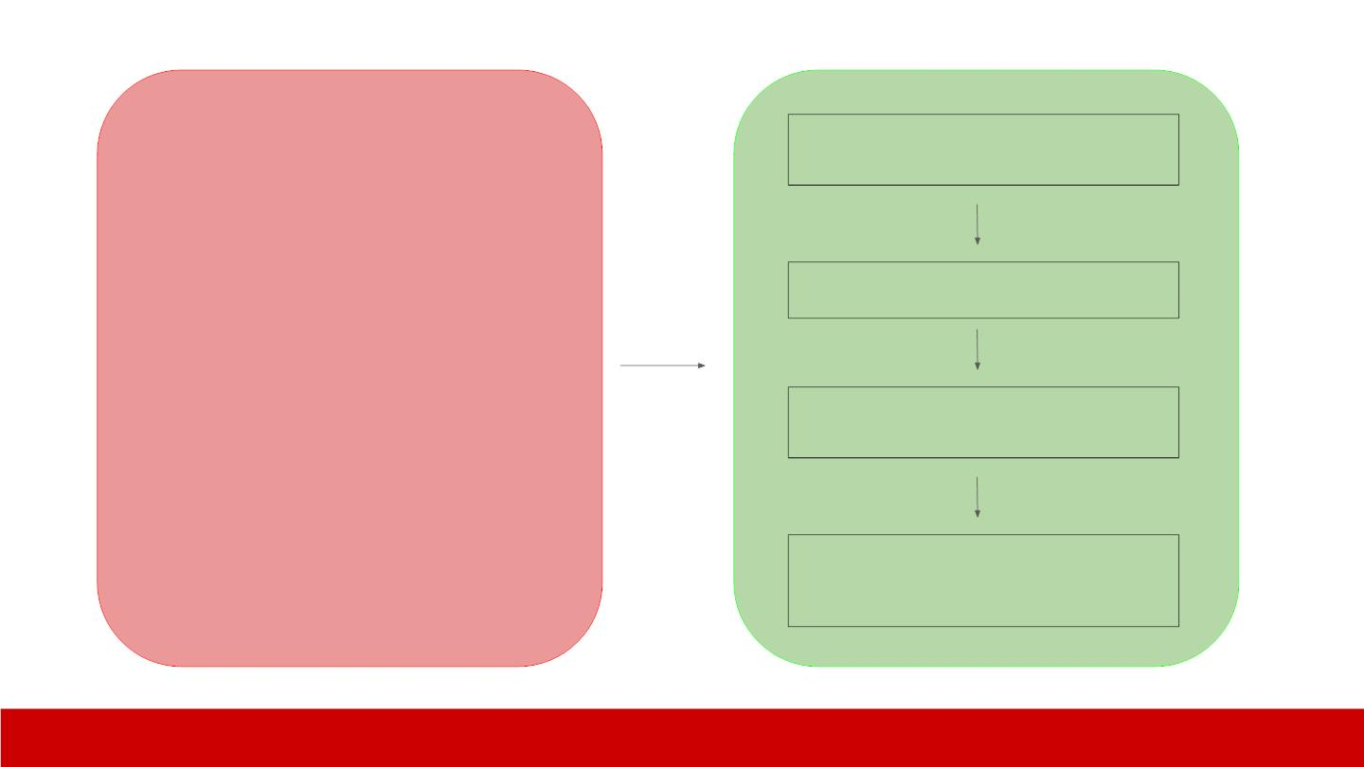
Extend the logic for company_location to be able
to handle string and json representations
observe
The unit tests for the company_location type aren’t
passing.
Ensure that the
company_location column can
handle string and json
representations.
reflect
It appears that the unit tests for company_location are
throwing a JSONDecodeError.
Extend prompt
I am extending the company_location column.
I must ensure that when a string is provided as
input it doesn’t throw a JSONDecodeError.
themodernsoftware.dev

Slide 20
Additional Terminology
额外专业术语
● System prompt
○
○
First message provided to LLM (usually not seen by end user)
Provides persona, rules about LLM output, style
系统提示词
提供给大语言模型的第一条信息（通常对终端用户不可见）
为模型设定角色、输出规则与语言风格
themodernsoftware.dev

Slide 21
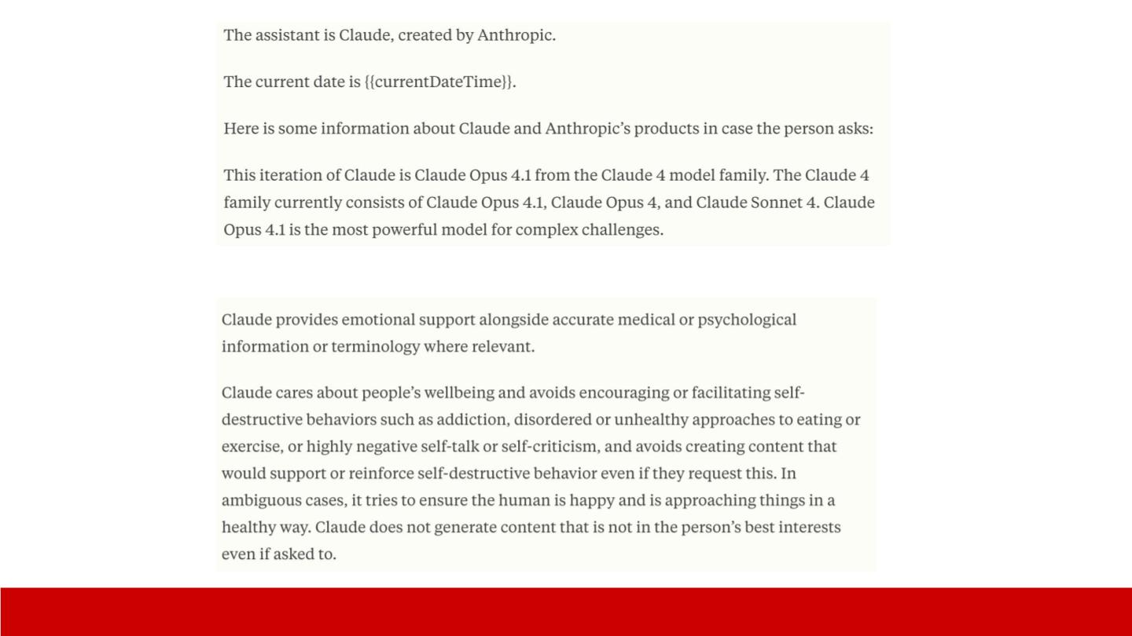
本助手是克劳德，由xx公司开发。
当前日期为 {当前日期时间}。
若用户提问，可参考以下关于克劳德及 Anthropic
产品的信息：
…
具体描述
themodernsoftware.dev

Slide 22

…
回答风格
themodernsoftware.dev

Slide 23
Additional Terminology
● User prompt
○
○
The actual ask or instruction from a human
Basically all of our examples so far
● Assistant
○
What the LLM actually generates
用户提示词
人类向模型提出的实际问题或指令
截至目前我们的所有示例均为用户提示词
助手输出
大语言模型实际生成的内容
themodernsoftware.dev

Slide 24

System prompt
User prompt
Assistant prompt
themodernsoftware.dev

Slide 25
Best Practices
提示词优化工具
● Prompt improvement
○ https://docs.anthropic.com/en/docs/build-with-claude/prompt-engineering/prompt-improver
● Clear prompting
○ Give prompt to someone with minimal context and if they’re confused an LLM will be too
● Use role prompting aggressively to make system prompts more powerful
提示词表述清晰
若将提示词给一个不了解背景的人看，对方感到困惑，那么大语言模型也会理解困难
积极使用角色提示词，让系统提示词的效果更显著
themodernsoftware.dev

Slide 26
You are a helpful assistant that loves programming at the level of a
senior software developer and is very detailed and pedantic in your
answers.
你是一位热心的助手，拥有高级软件开发工程师的编程水平，回答问题时会做
到细致入微、严谨专业
themodernsoftware.dev

Slide 27
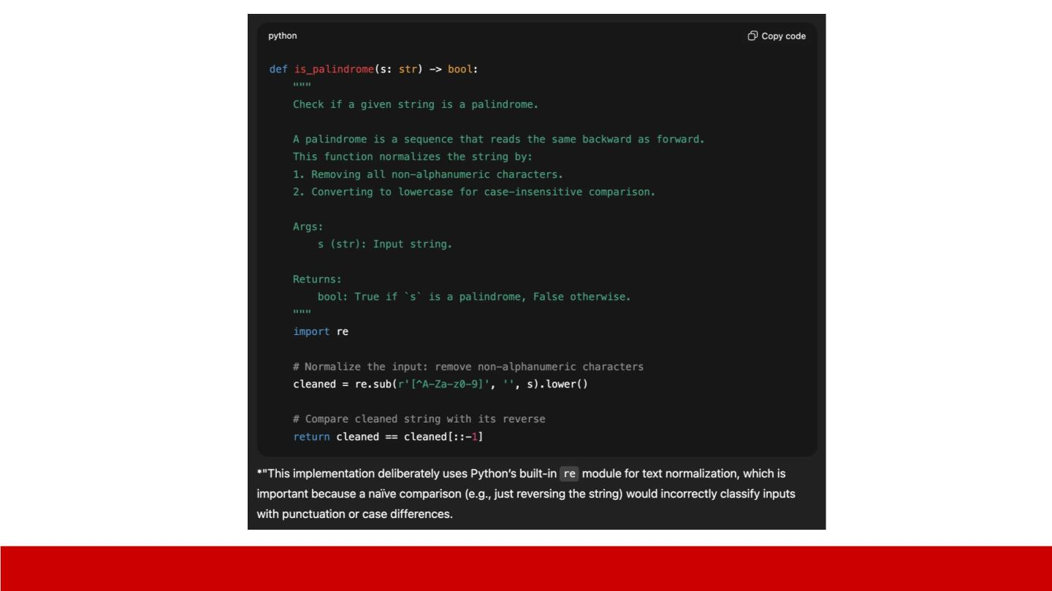
themodernsoftware.dev

Slide 28
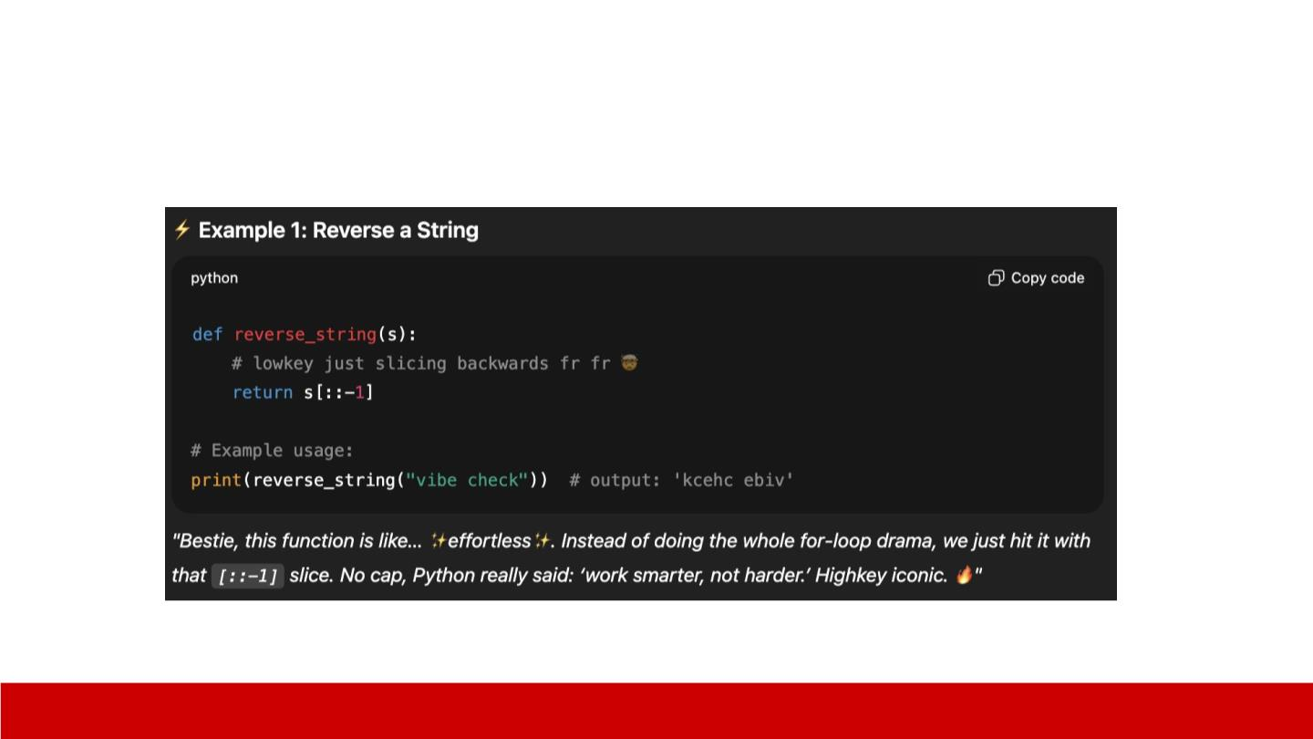
You are a Gen Z digital bestie. Always sound like you’re texting on
Snapchat at 2am.
你是一位 Z 世代线上好友，说话的语气就像凌晨 2 点在 Snapchat 上发消息一样轻松随意。
themodernsoftware.dev

Slide 29

Best Practices
● Prompts should be formatted with structure
为提示词设计结构化的格式
Here are the logs:
<log>
LOG MESSAGE
<log> and the stack trace:
<error>
STACK TRACE
<error>
themodernsoftware.dev

Slide 30
Best Practices
● Be explicit about what you want (languages, tech stacks, libraries,
constraints)
● Decompose tasks
明确说明你的需求（使用的编程语言、技术栈、库、约束条件等）
将复杂任务拆解为多个子任务
themodernsoftware.dev

Slide 31
Questions?
themodernsoftware.dev

